Slide 1
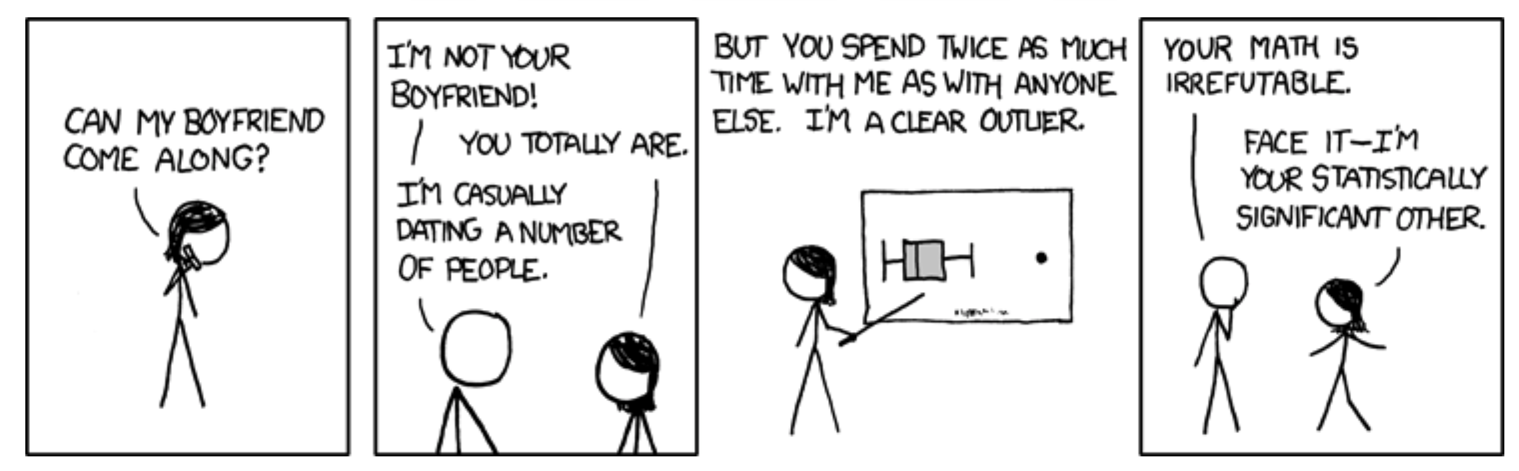
Binary Response Variables, Random vs Fixed Effects, and Outliers Biology 683 Lecture GLM2 Heath Blackmon

Slide 2
Likelihood and AIC model selection
Think of likelihood as how probable the observed data are under the current model. When we fit a glm we are getting the likelihood of the data assuming the best values for the parameters (beta coefficients). For any empirical dataset these will be very small numbers. It is easy for computers to store the log of very small numbers which means that log likelihoods will be negative numbers.
likelihood = .01
likelihood = .0001
ln(L) = -4.6
ln(L) = -9.2
better fit
worse fit
Adding additional predictor variables will always improve the fit of the data under the model.
R example
So we must penalize for extra parameters
R example
fit1 <- glm(y ~ a)
fit2 <- glm(y ~ a + b)
anova(fit1, fit2, test=“LRT”)

Slide 3
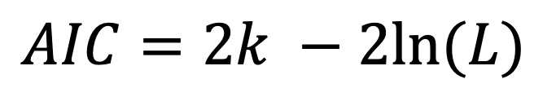
Likelihood and AIC model selection
$$AIC=2k −2ln⁡(L)$$
k number of parameters
ln(L) log likelihood of the data (a big negative number)
Models with smaller numbers are better
Differences in AIC can be used to evaluate evidence for one model vs. another.
A model with a ΔAIC value within 1-2 of the best model has substantial support, and should be considered along with the best model.
A ΔAIC value within only 4-7 units of the best model has considerably less support.
A ΔAIC value > 10 indicates that the worse model has virtually no support and should not be consideration.
Burnham and Anderson 1998

Slide 4
Likelihood and AIC model selection
LRT: Does adding this predictable variable reduce the deviation from predictions more than I would expect if the predictor had no impact on the response variable (alpha = .05)
AIC: Is about comparing models and finding the model(s) that seem to match with the data we are observing.
If you are going to use AIC to choose “best” model pay attention to close seconds and whether they “tell a different story”

Slide 5
Likelihood and AIC model selection
STOP HERE FOR TUESDAY

Slide 6
Logistic Regression
Questions where the response variable is binary are common.
Dispersal vs Non-dispersal
Survival
Presence/Absence of a trait
Infected/uninfected

Slide 7
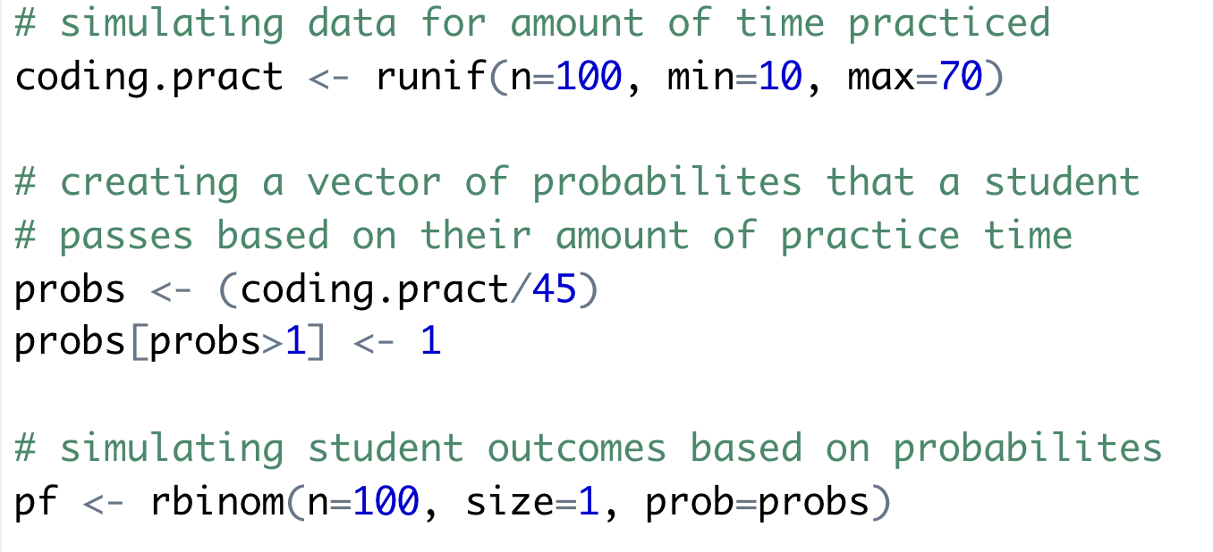
Logistic Regression

Slide 8
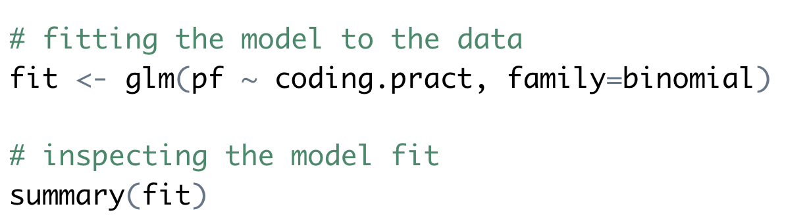
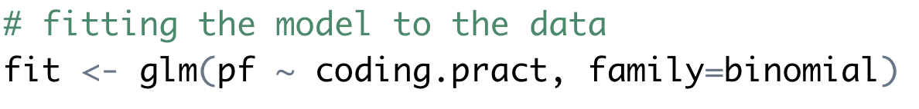
Logistic Regression

Slide 9
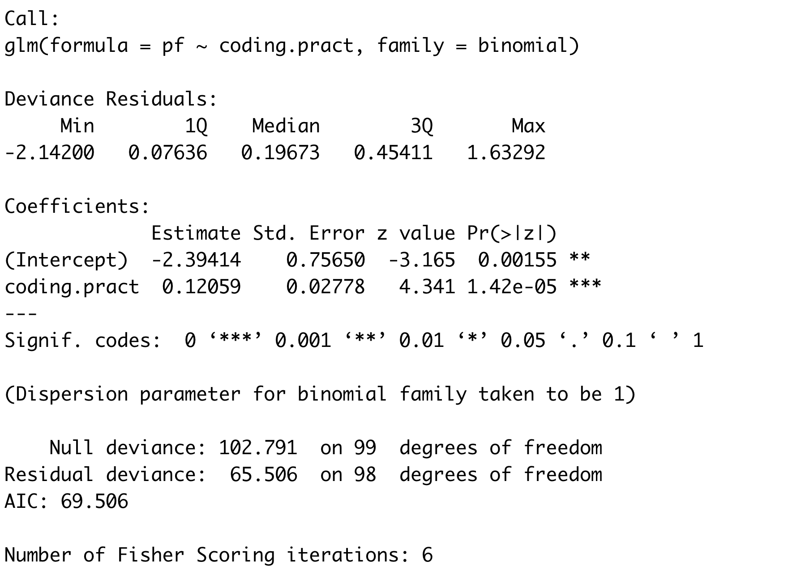
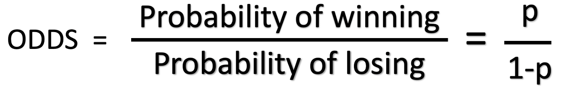
Logistic Regression
log(odds)

Slide 10
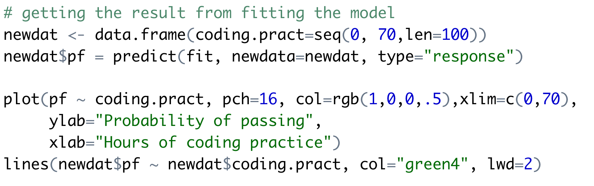
Logistic Regression

Slide 11
Logistic Regression

Slide 12
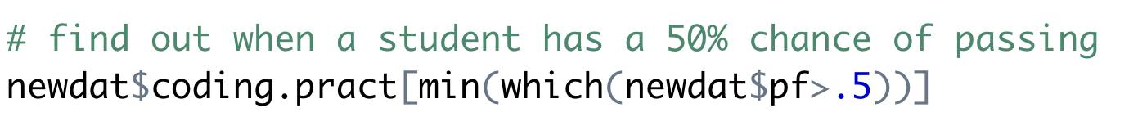
Logistic Regression
> 25.45

Slide 13
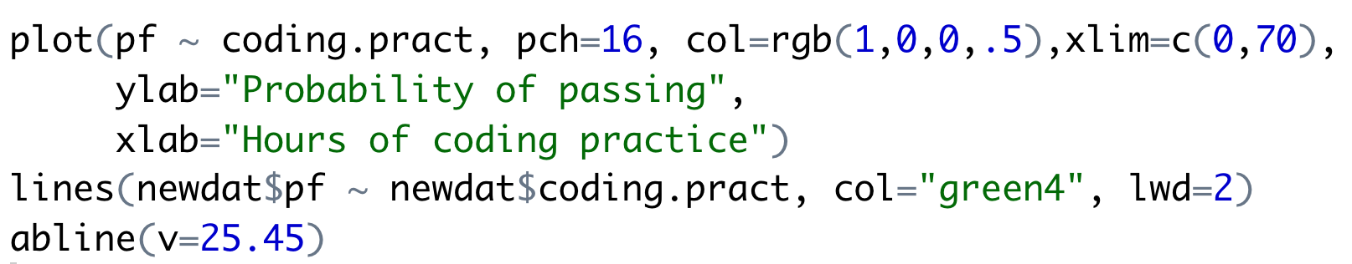
Logistic Regression
> 25.45

Slide 14
Logistic Regression
> 25.45

Slide 15
Logistic Regression
> 25.45
How does this compare to what we expected from the simulation?
> 25/45
[1] 0.5555556

Slide 16
Mixed models
Mixed models are models that include fixed and and random effects.
Fixed effects can be repeated by other researchers. These are the variables that you are interested in studying.
Random effects are usually nuisance parameters. These are variables that other researchers cannot replicate and you are not interested in inferring anything about them.

Slide 17
Mixed models
Fixed effects are the variables whose impact we wish to determine
Characteristics of the media or habitat
Experimental treatments
Age groups
Time points
Mutant genotypes
Conclusions that you reach are only applicable to the groups or treatments you include in the study

Slide 18
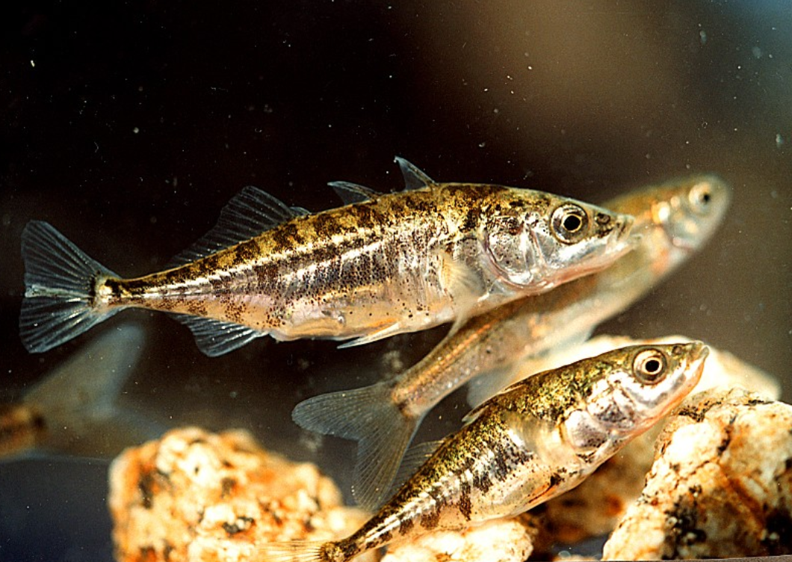
Example of fixed effects
Reciprocal relocation experiment to investigate how genotype and habitat interact to determine the fitness of stickleback fish (Rundle 2002).
 |  | Source habitat
 |  | Shallow | Deep
Test habitat | Shallow | 12 fish | 11 fish
 | Deep | 7 fish | 11 fish

Slide 19
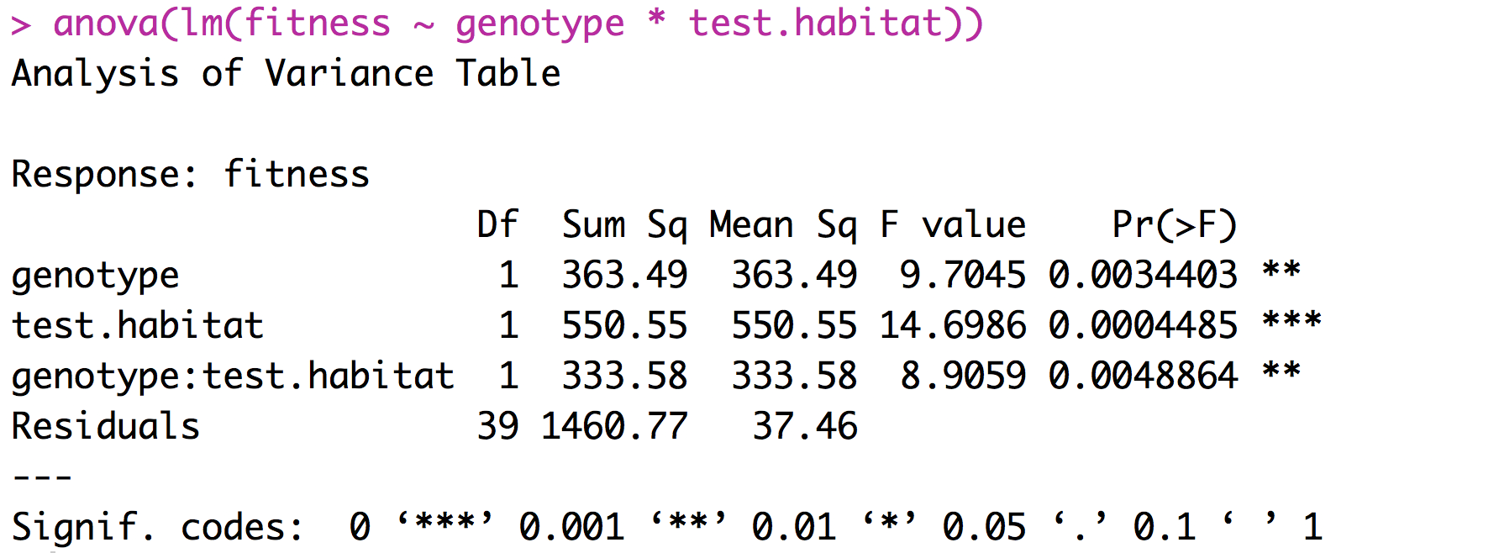
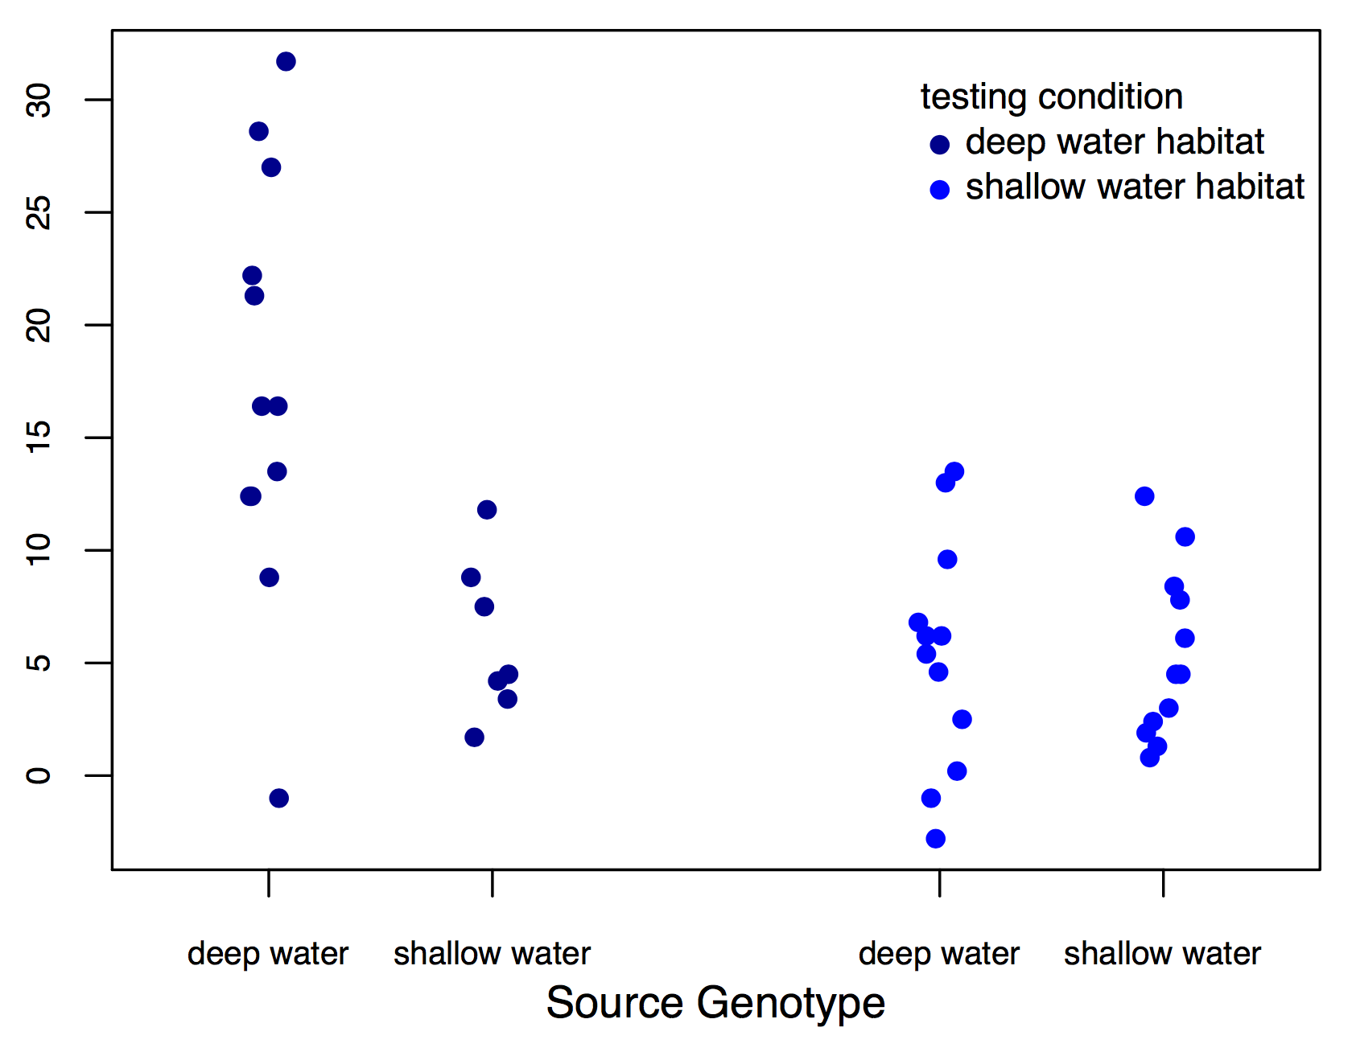
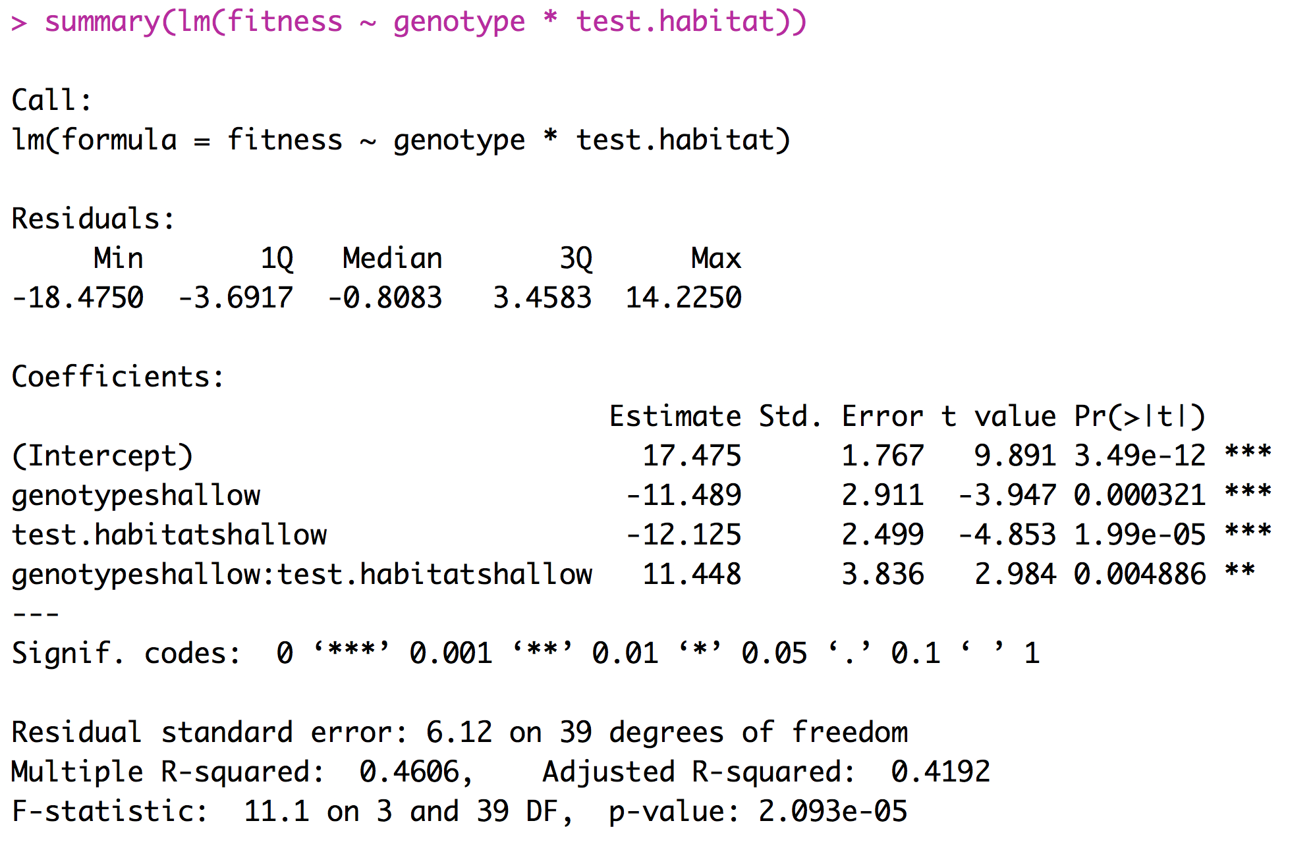
Example of fixed effects (two factor ANOVA)
fitness

Slide 20
Interpreting Coefficients

Slide 21
What is a random effect
These are randomly sampled categories of a variable that represent groups of individual measurements. Usually random effects are not repeatable.
Study sites
Environmental chambers
Families made up of siblings
Measurements within individuals
Conclusions that you reach are applicable only to the sample being studied.

Slide 22
What is a random effect
Sometimes random effects are a nuisance
Field sites
Environmental chambers
Field plots
Repeated measures
Occasionally random effects are of great interest
Families - Heritability
Individuals – Breeding value

Slide 23
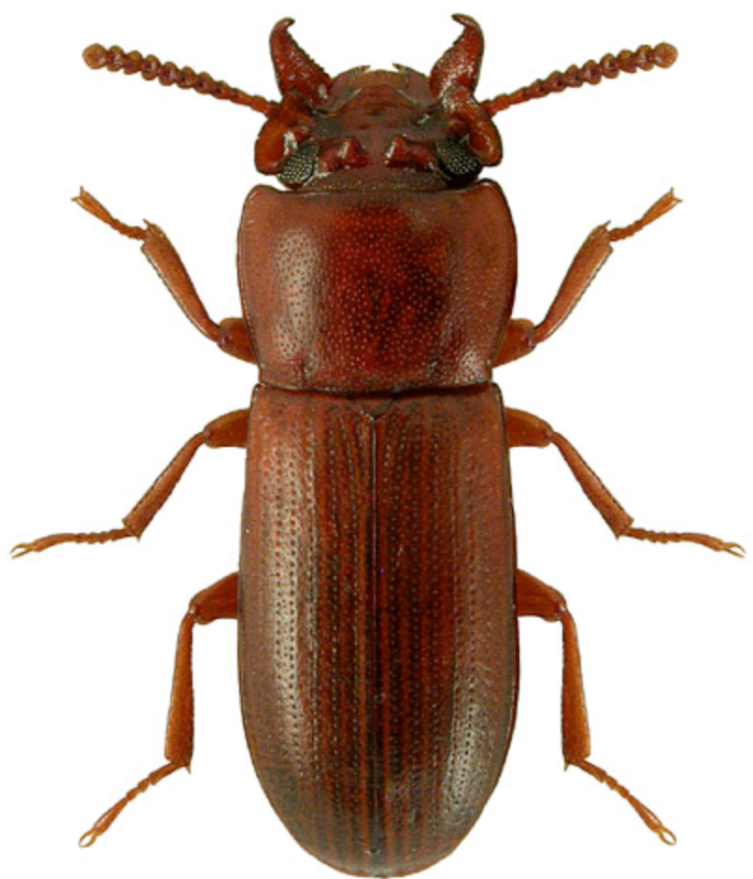
Example of random effects
Impact of selective regime on horn size. Measure both the left and right horn in 25 beetles from two different selective regimes.
Horn size | Beetle | Selective regime
256 276 321 321 423 401 381 409 | 1 1 2 2 3 3 4 4 | High High High High Low Low Low Low

Slide 24
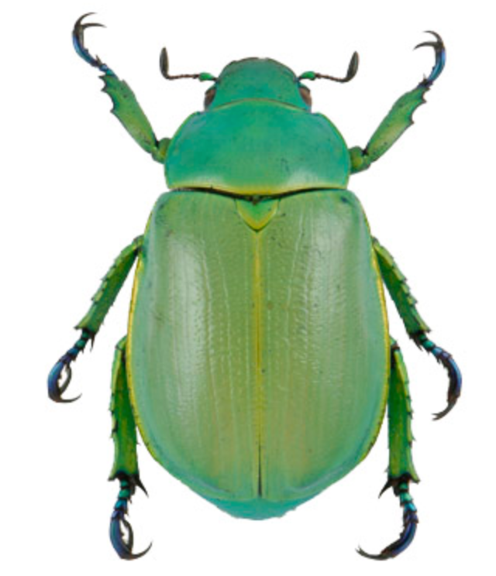
Example of random effects
Identifying the predictors for the presence or absence of Chrysina beetles.
Number collected | oak | juniper | site | date | trip
8 2 1 5 4 6 0 7 | 1 1 0 0 1 1 1 1 | 0 1 1 1 1 0 1 1 | 21 13 31 15 21 13 31 15 | 210 210 211 212 242 242 245 245 | A A A A B B B B

Slide 25
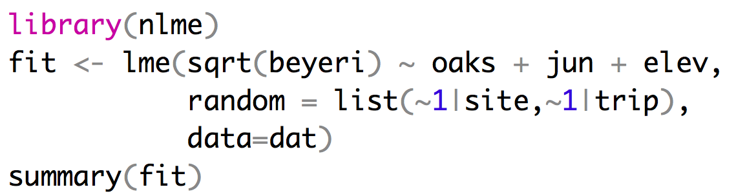
Implementing a mixed effects model
Mixed effect models can be fit using the LME function from the package nlme.
Fixed effects
Random effects
Repeated measures at sites can’t
be treated as independent

Slide 26
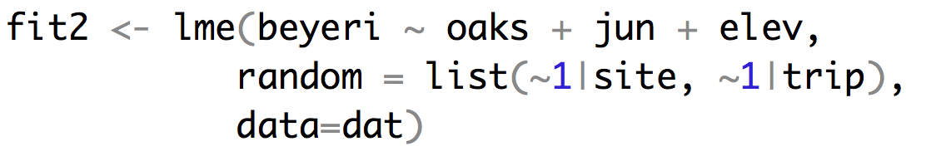
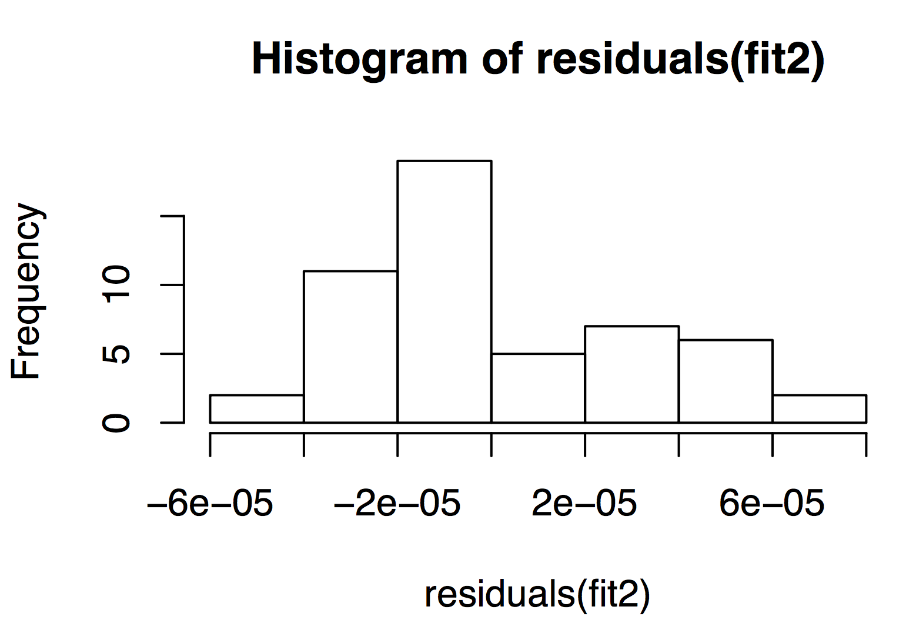
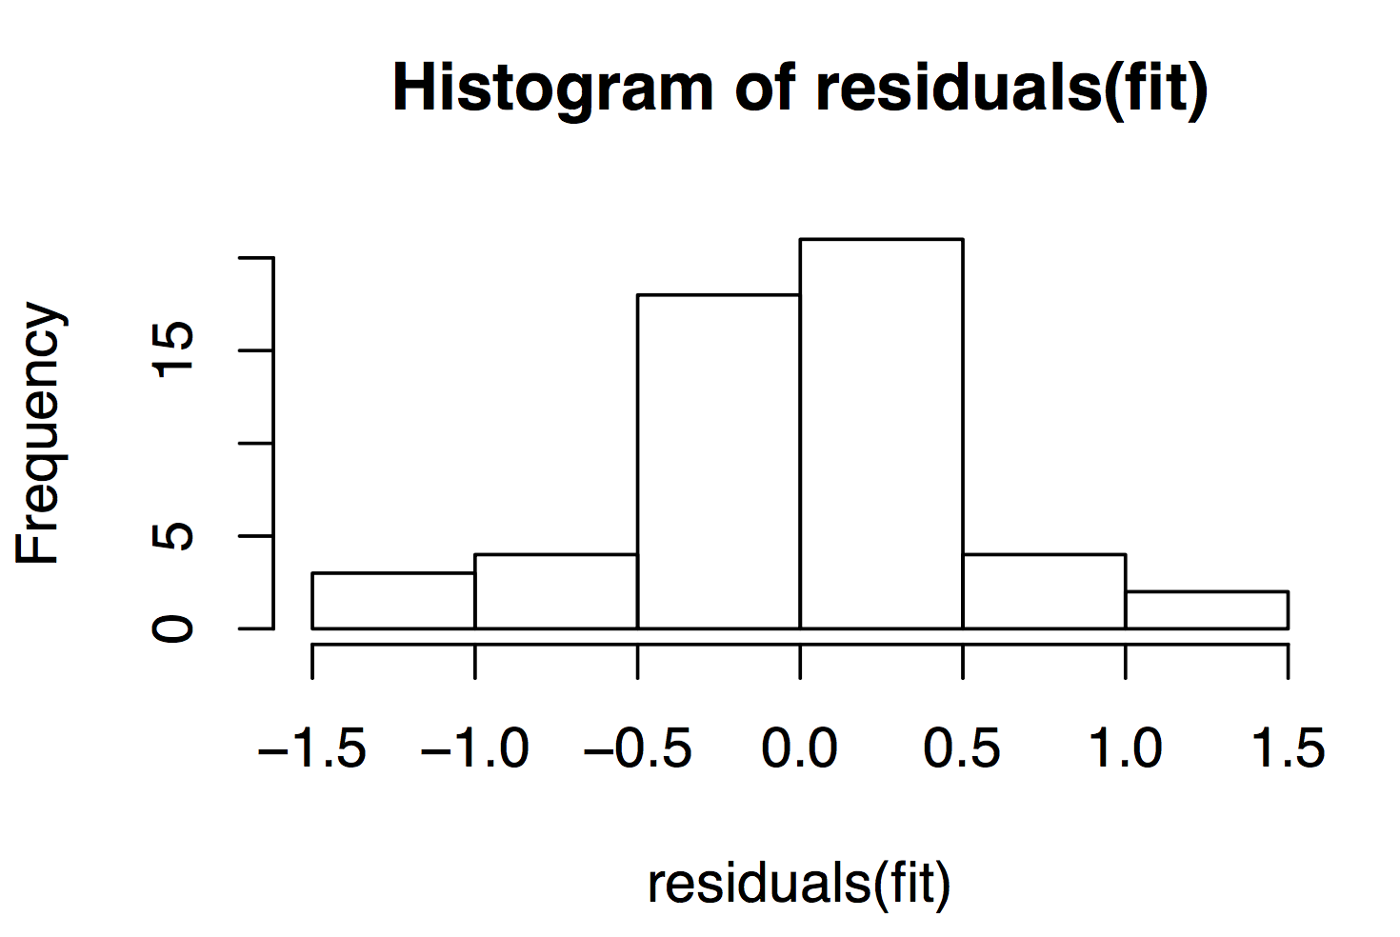
Implementing a mixed effects model

Slide 27
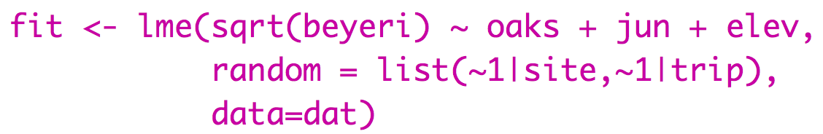
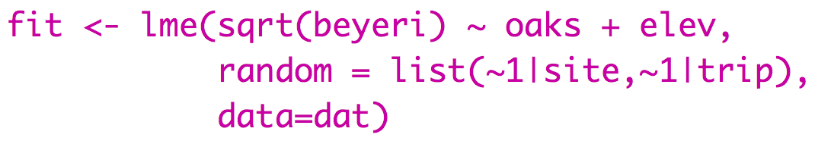
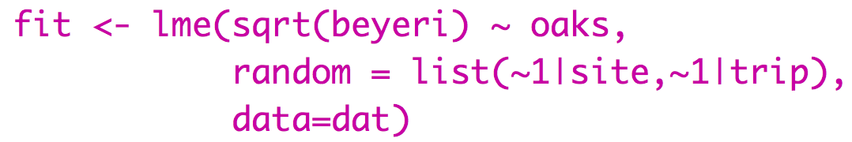
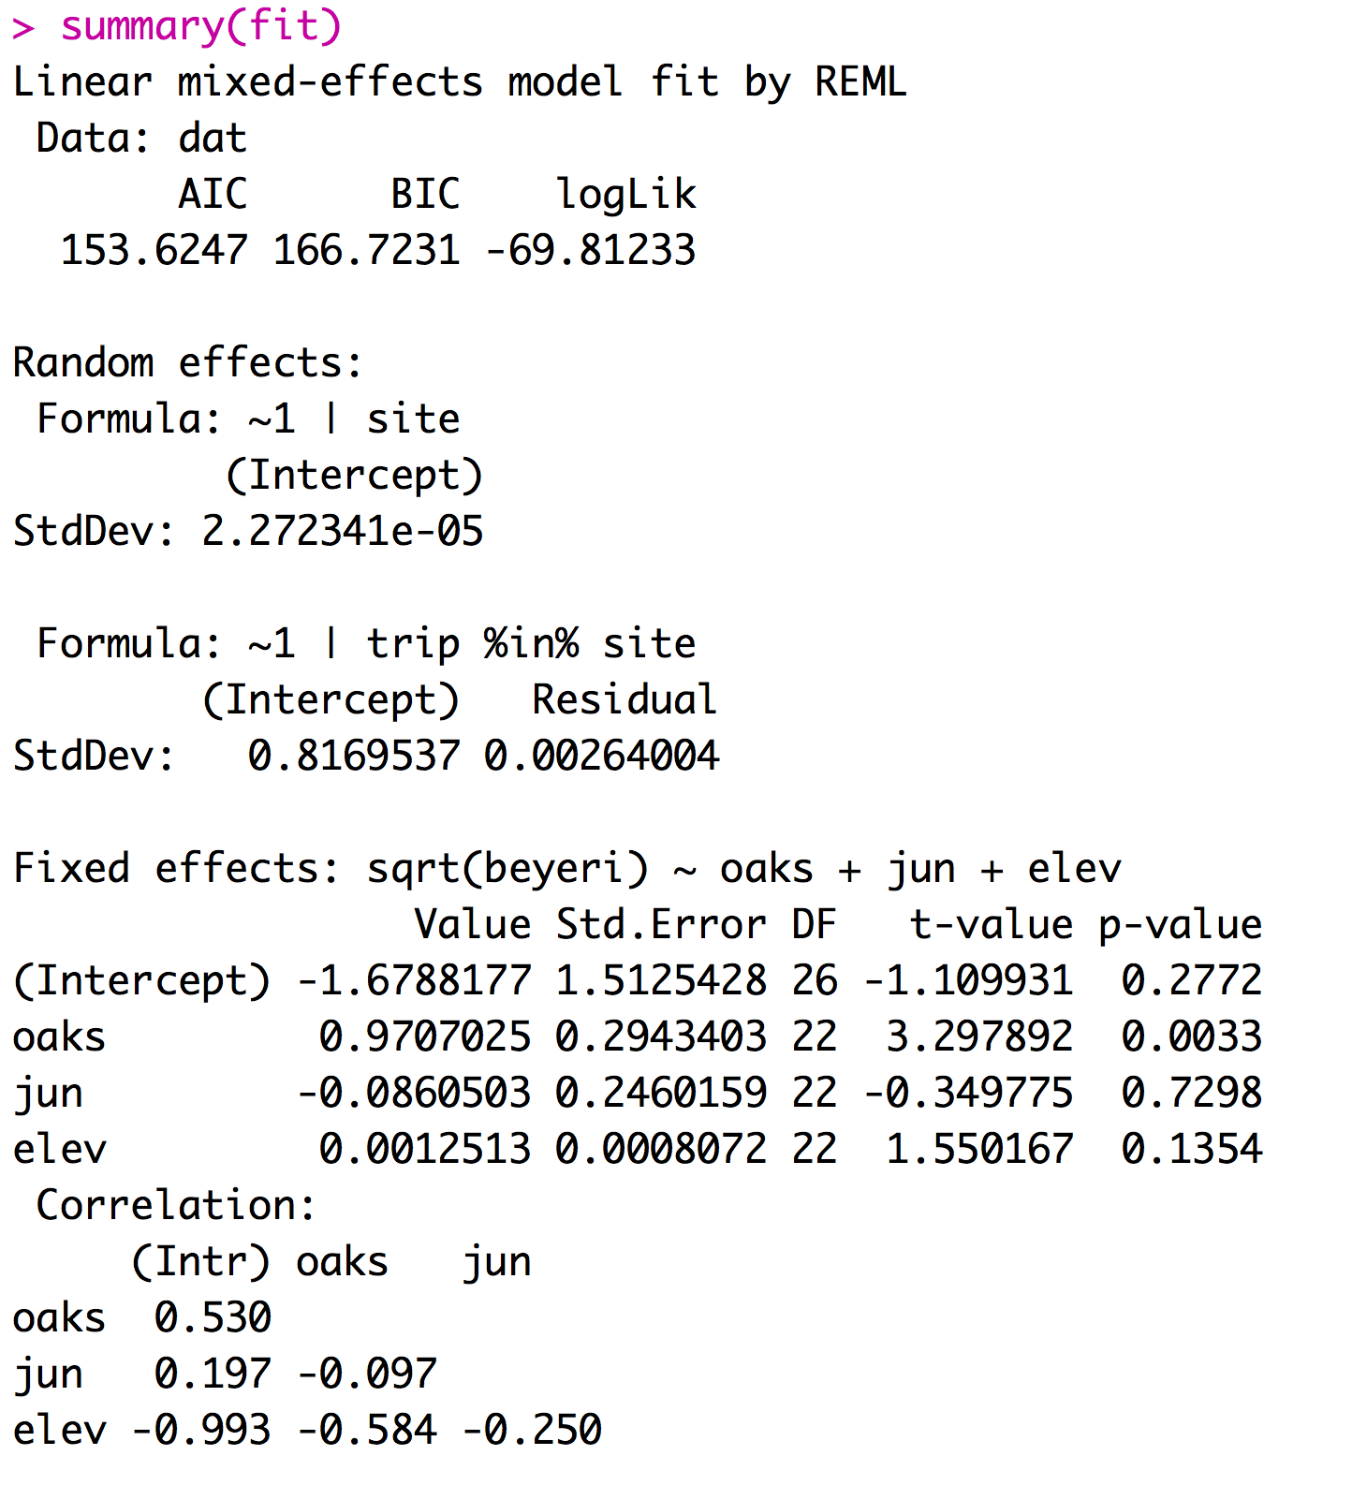
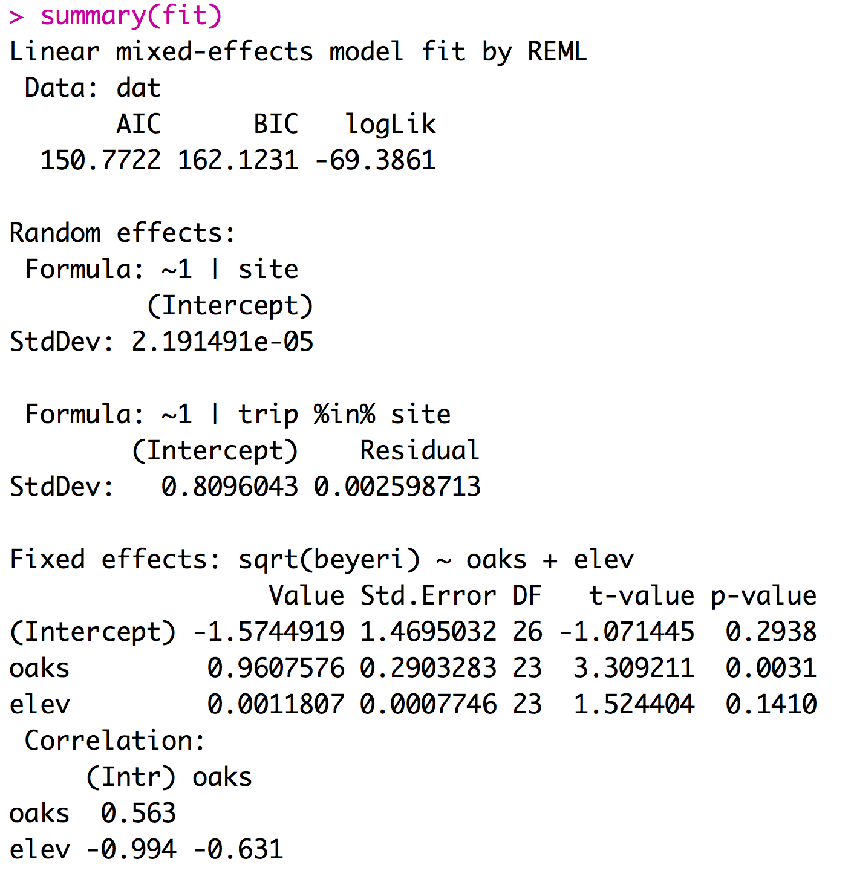
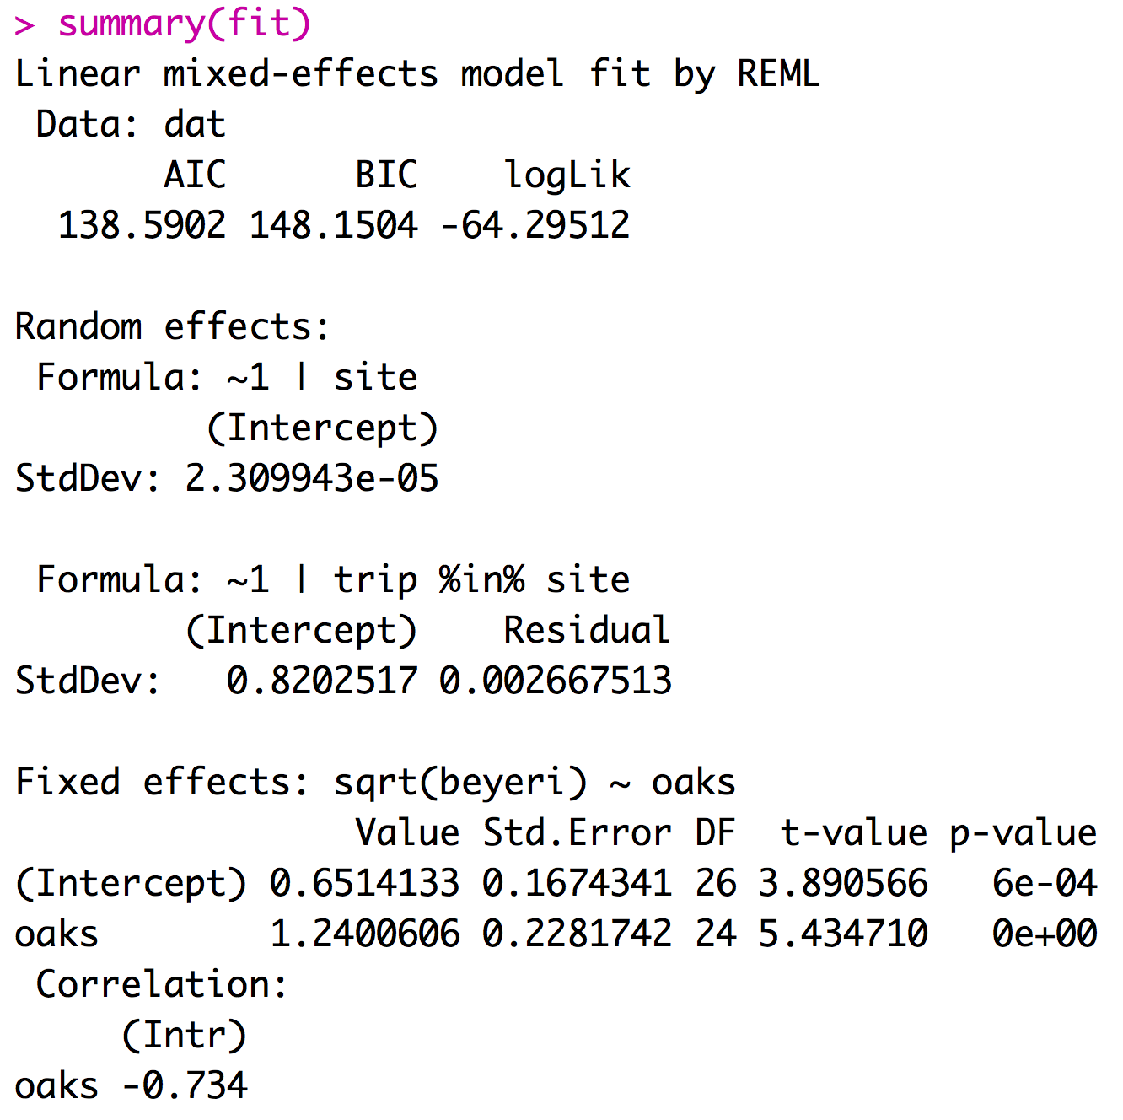
Implementing a mixed effects model
Mixed effect models can be fit using the LME function from the package nlme.
If you report your df with your F-statistic the reviewer will know if you did the right type of model

Slide 28
Considerations for models with random effects
Most software will assume that all factors are fixed unless you specify them as mixed.
Designating factors as random effects takes extra work.
The lm function treats all predictors as fixed effects.
Treating random effects as fixed effects is fundamentally wrong.

Slide 29
4 Types of outliers
1) Obviously erroneously recorded or measured data
3) Extreme data point that impacts statistic of interest.
2) Extreme data point that doesn’t impact statistic of interest but does impact p-value.
4) Extreme data point that creates significance.

Slide 30
Links
MCMCMglmm: Fit mixed models with phylogenetic or pedigree information in a Bayesian framework.
Outlier Package: Apply outlier tests to identify possible outlier datapoints - I don’t recommend this.
If time permits: repeated median regression (Theil-Sen Estimator)
simulate x and y with medium strength relationship and add one outlier
standard regression record Beta
record slope between all pairs and find median slope
repeat standard regression without outlier

